Slide 1
Cracking Windows Passwords

Slide 2
Overview
How Windows Stores Passwords
Rainbow table attack
Cracking Windows Passwords with John the Ripper/Hashcat
Cracking Windows Passwords with Cain

Slide 3
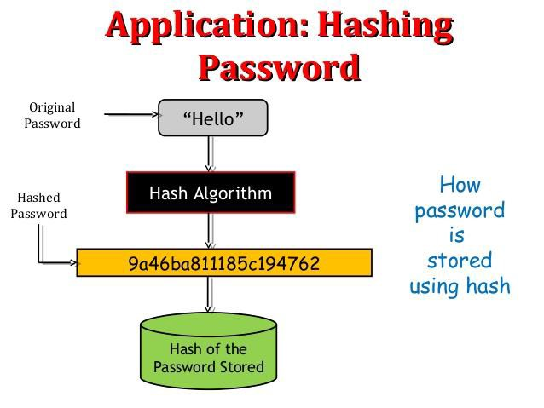
How Windows Stores Passwords

Slide 4
How to hash user passwords
Two methods of hashing of user passwords
LAN Manager (LM)
NT LAN Manager (NTLM)
A hash is the result of a cryptographic function that takes an arbitrarily sized string of data, performs a mathematical encryption function on it, and returns a fixed-size string.
LM hash
NTLM hash

Slide 5
LM vs NTLM
LAN Manager (LM)
Old method
Data Encryption Standard (DES)
Windows 2000, XP, Vista, and 7
NT LAN Manager (NTLM)
the successor of LM
MD4 hashing algorithm
Implemented with Windows NT 4

Slide 6
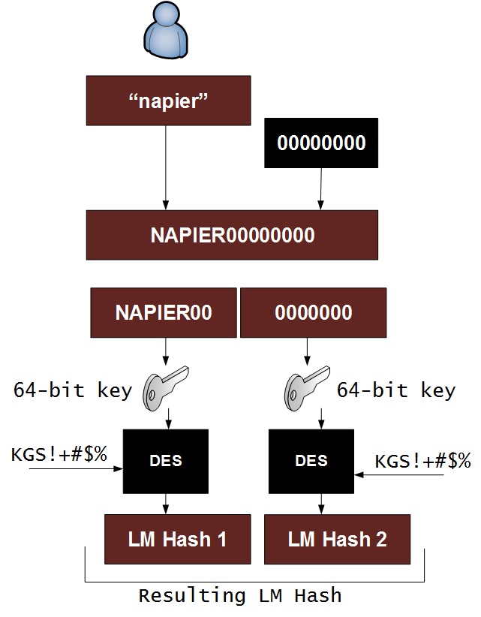
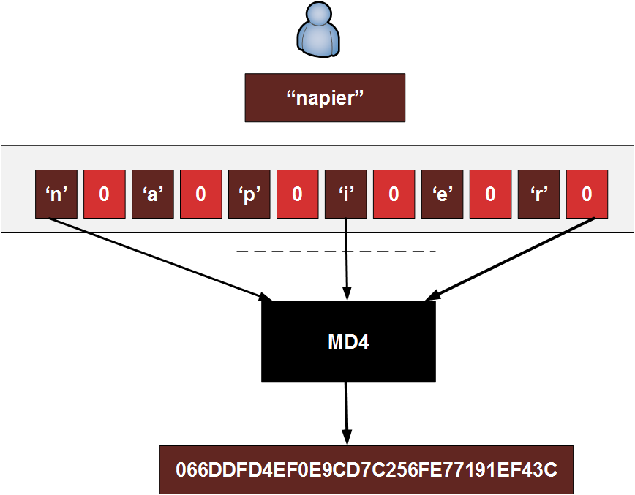
LM vs NTLM

Slide 7
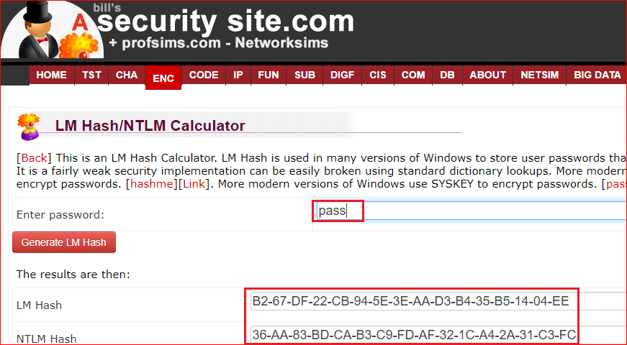
Try by yourself
https://asecuritysite.com/encryption/lmhash?sortby=hashme
B267DF22CB945E3EAAD3B435B51404EE
36AA83BDCAB3C9FDAF321CA42A31C3FC

Slide 8
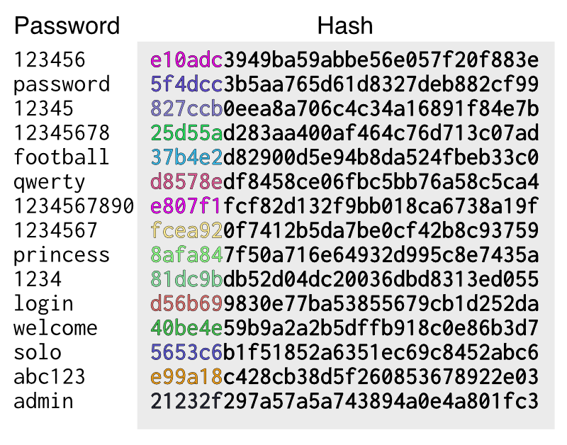
Weakness of NTLM
Brute force attack
not working with long password
Dictionary attack
not working with long password
Problem of these attacks
Need large space if password is long

Slide 9
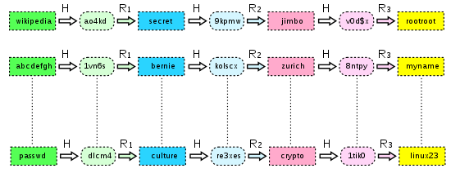
Rainbow tables attack
For any h in Hashes, if R(h)->H() is found in Plaintext, we can find P
A precomputed table for reversing cryptographic hash functions,
Need more space
Plaintexts
Hashes
R
p
H

Slide 10
How extract NTLM hashcode using Pwdumer7
Tested on Win 7 and Win 8.1. Does not work on Win 10

Slide 11
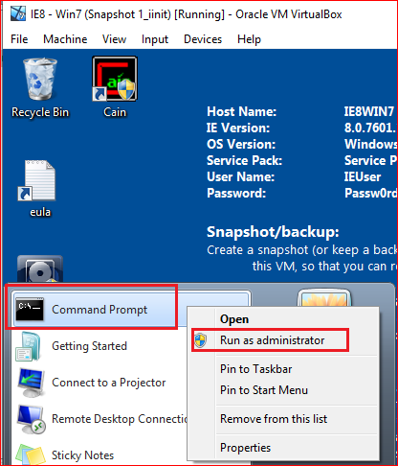
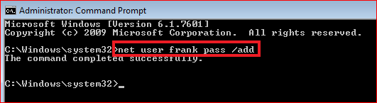
Creating Passwords
net user frank pass /add

Slide 12
Location of NTLM hashes
Stored in the Windows SAM file.
C:\Windows\System32\config
is not accessible while the operating system is booted up.
The registry at HKEY_LOCAL_MACHINE\SAM
not accessible while the operating system is booted.

Slide 13
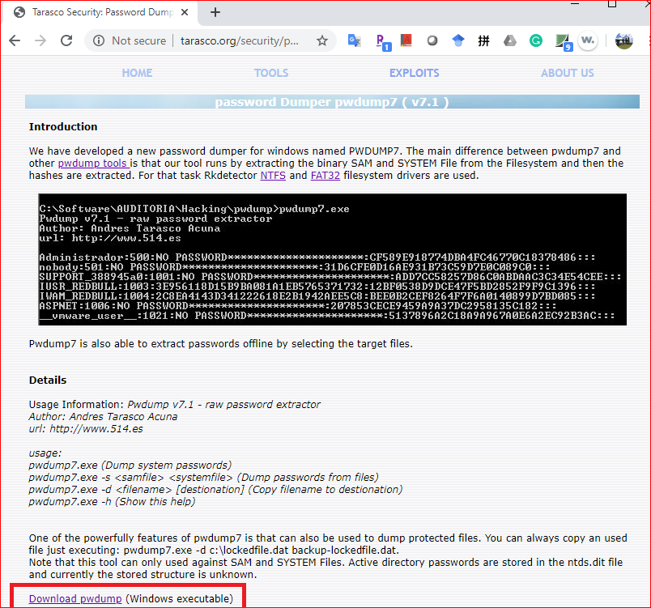
Download Password Dumper
http://www.tarasco.org/security/pwdump_7/
Disable anti-virus if download fails. See next slide

Slide 14
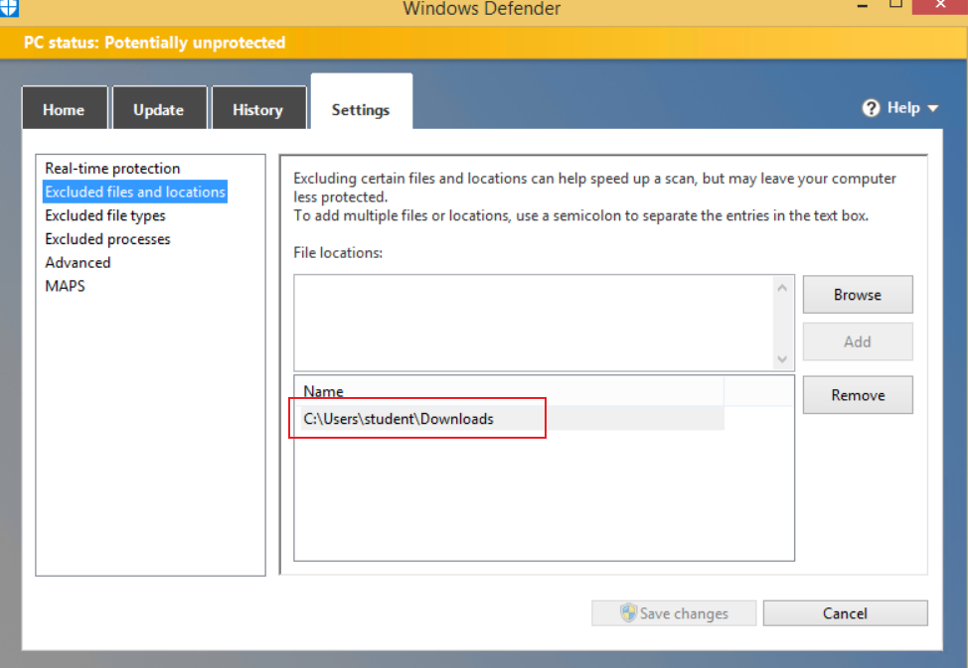
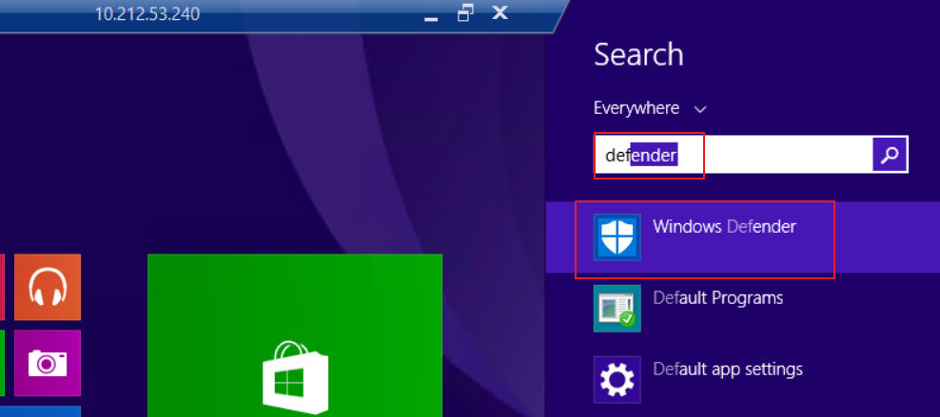
Disable Anti-virus (Win 8)

Slide 15
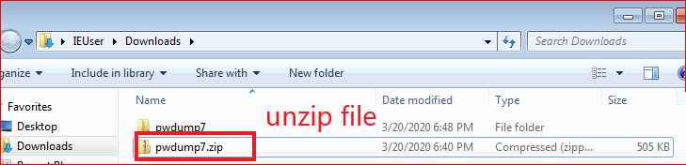
Unzip pwdump7/zip

Slide 16
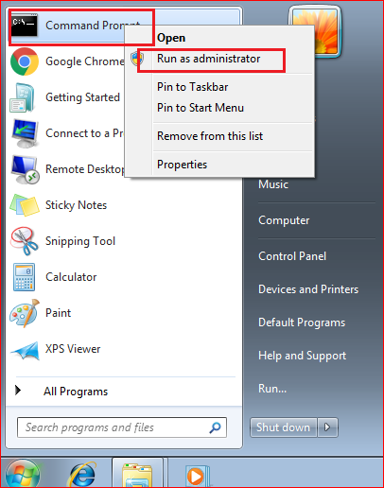
Open Command Prompt
With administrator

Slide 17
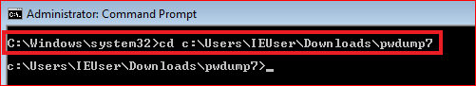
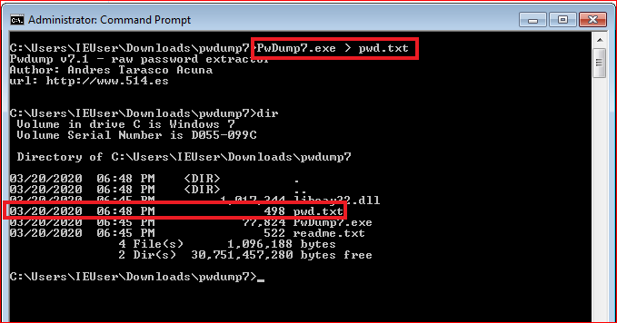
Run dump command

Slide 18
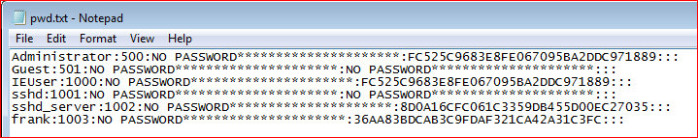
Extracted NTML hashes (Local VM- Win 7)
Administrator:500:NO PASSWORD*********************:FC525C9683E8FE067095BA2DDC971889:::
Guest:501:NO PASSWORD*********************:NO PASSWORD*********************:::
IEUser:1000:NO PASSWORD*********************:FC525C9683E8FE067095BA2DDC971889:::
sshd:1001:NO PASSWORD*********************:NO PASSWORD*********************:::
sshd_server:1002:NO PASSWORD*********************:8D0A16CFC061C3359DB455D00EC27035:::
frank:1003:NO PASSWORD*********************:36AA83BDCAB3C9FDAF321CA42A31C3FC:::

Slide 19
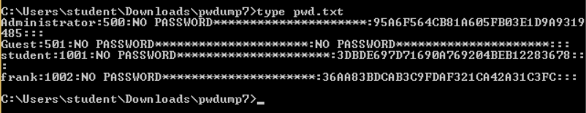
Windows 8.1 (elum VM)
Administrator:500:NO PASSWORD*********************:95A6F564CB81A605FB03E1D9A9319485:::
Guest:501:NO PASSWORD*********************:NO PASSWORD*********************:::
student:1001:NO PASSWORD*********************:3DBDE697D71690A769204BEB12283678::
:
frank:1002:NO PASSWORD*********************:36AA83BDCAB3C9FDAF321CA42A31C3FC:::

Slide 20
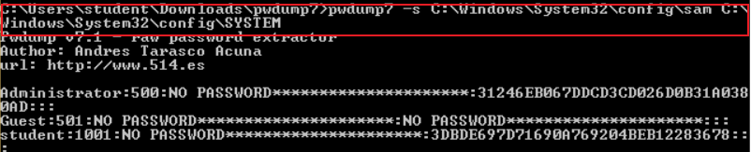
(optional) command line: specify SAM and SYSTEM

Slide 21
Cracking Windows Passwords with John Ripper/Hashcat

Slide 22
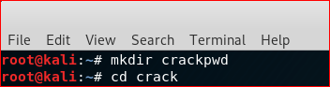
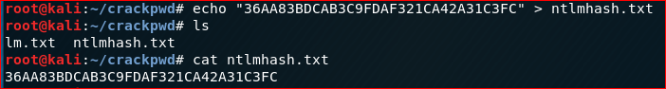
Try use Kali

Slide 23
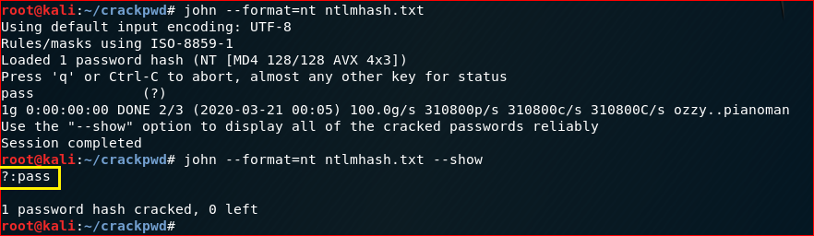
Crack with JohnRipple

Slide 24
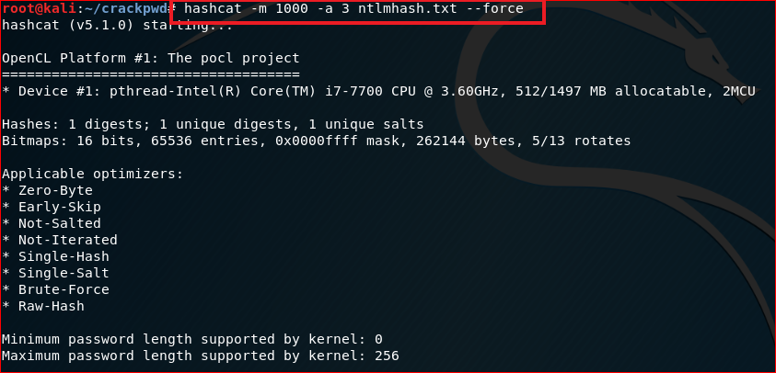
Crack with Hashcat

Slide 25
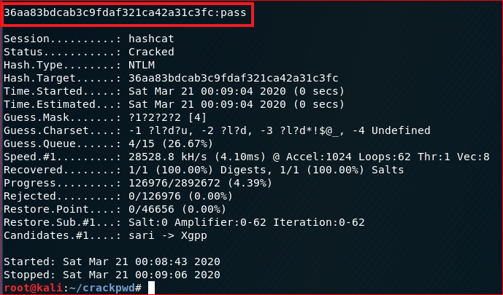

Slide 26
Notes
If you want to crack again

Slide 27
Cracking Windows Passwords with Cain

Slide 28
Cracking Windows Passwords with Cain
Works in Windows 7, 8
Cain will be detected as malware by your virus scanner.

Slide 29
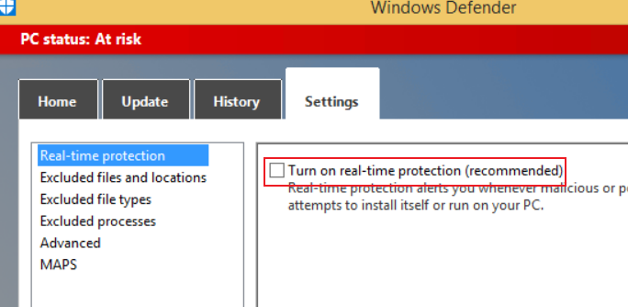
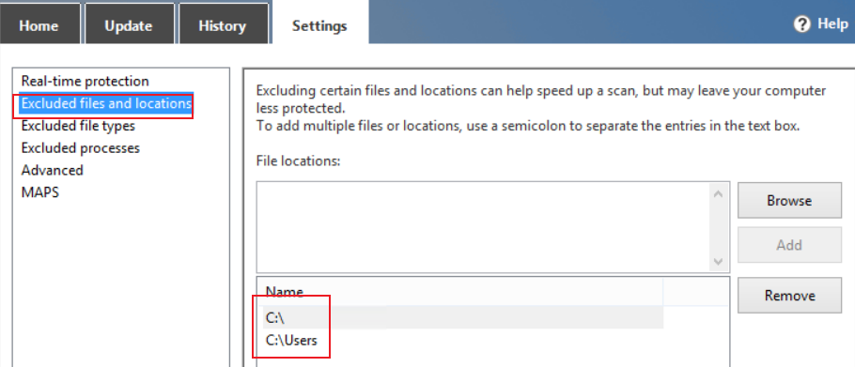
Disable Win8 Anti-virus

Slide 30
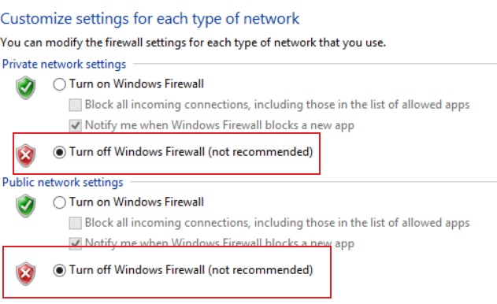
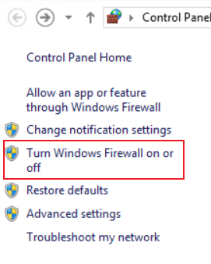
Disable firewall

Slide 31
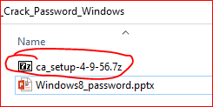
Download Cain
Option 1
https://samsclass.info/123/proj10/ca_setup-4-9-56.7z
Password: sam
Option 2

Slide 32
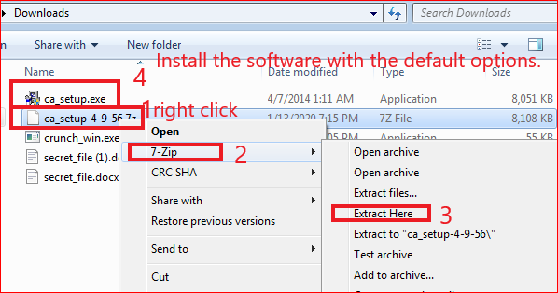
Installing Cain
If you don't have 7-Zip, get it here:
http://www.7-zip.org/

Slide 33
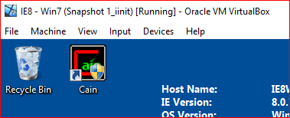
After installation

Slide 34
Creating Passwords
net user frank pass /add

Slide 35
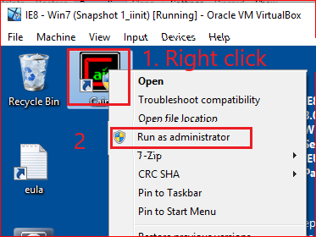
Show Password Hashes

Slide 36
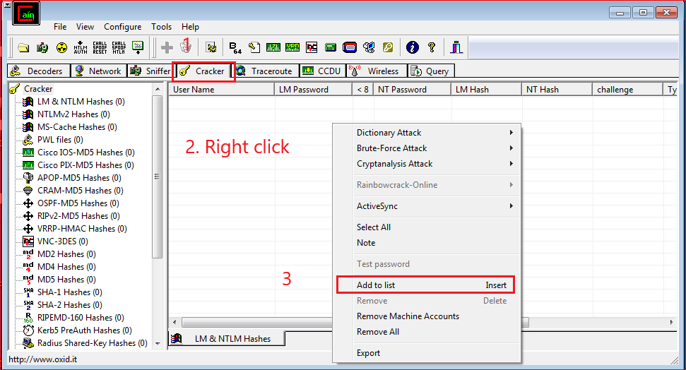

Slide 37
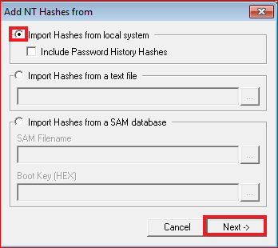
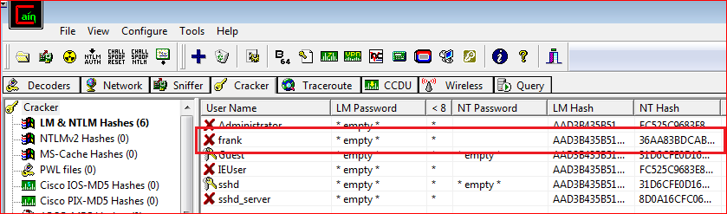

Slide 38
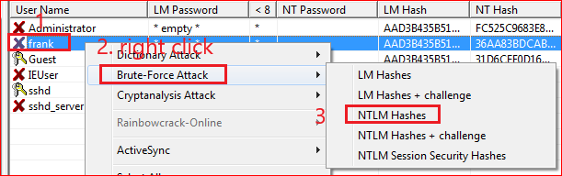
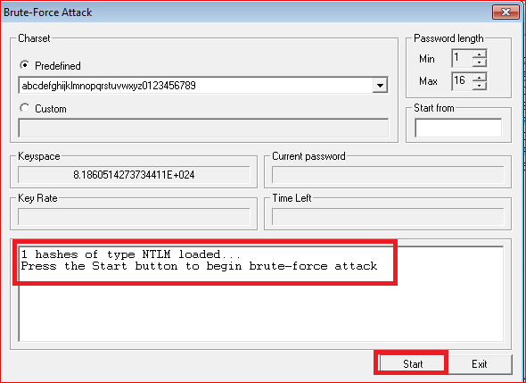
Cracking Passwords

Slide 39
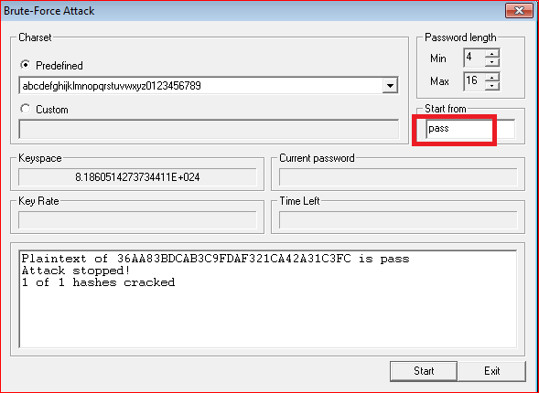
Results

Slide 40
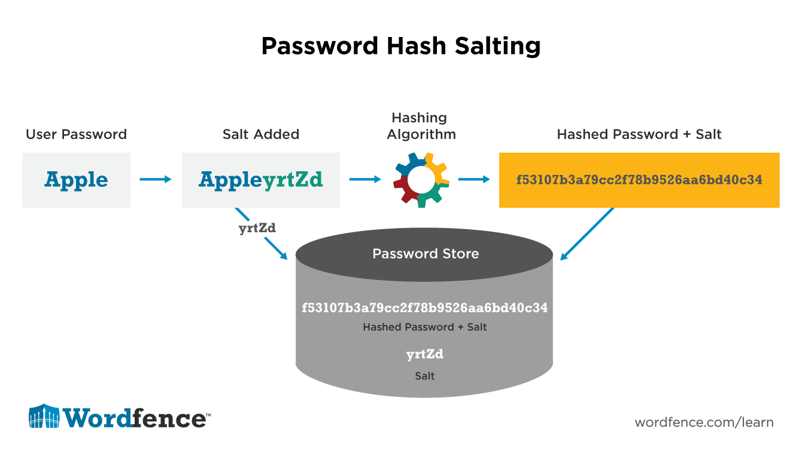
Prevent Attacks

Slide 41
Extra credit: rainbow table attack
Use hashcat to brute-force all 1-7 character passwords (this can be done quickly).
Use hashcat to crack passwords based on rules (variable time).
Use rainbow tables to break complex 8-character passwords (a few hours).
Use rainbow tables to break complex 9-character passwords (a few days).
https://www.rainbowcrackalack.com/

Slide 42
Reference
http://pentestmonkey.net/cheat-sheet/john-the-ripper-hash-formats

Slide 43
Crack Windows 10 password

Slide 44
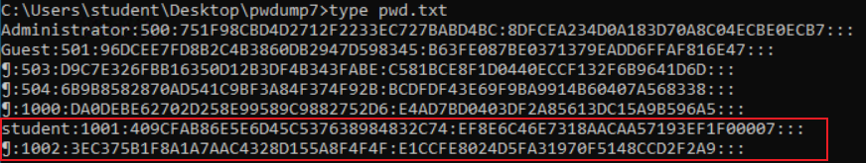
Windows 10 password hash using pwdump 7-Useless due to no username
Administrator:500:751F98CBD4D2712F2233EC727BABD4BC:8DFCEA234D0A183D70A8C04ECBE0ECB7:::
Guest:501:96DCEE7FD8B2C4B3860DB2947D598345:B63FE087BE0371379EADD6FFAF816E47:::
¶:503:D9C7E326FBB16350D12B3DF4B343FABE:C581BCE8F1D0440ECCF132F6B9641D6D:::
¶:504:6B9B8582870AD541C9BF3A84F374F92B:BCDFDF43E69F9BA9914B60407A568338:::
¶:1000:DA0DEBE62702D258E99589C9882752D6:E4AD7BD0403DF2A85613DC15A9B596A5:::
student:1001:409CFAB86E5E6D45C537638984832C74:EF8E6C46E7318AACAA57193EF1F00007:::
¶:1002:3EC375B1F8A1A7AAC4328D155A8F4F4F:E1CCFE8024D5FA31970F5148CCD2F2A9:::

Slide 45
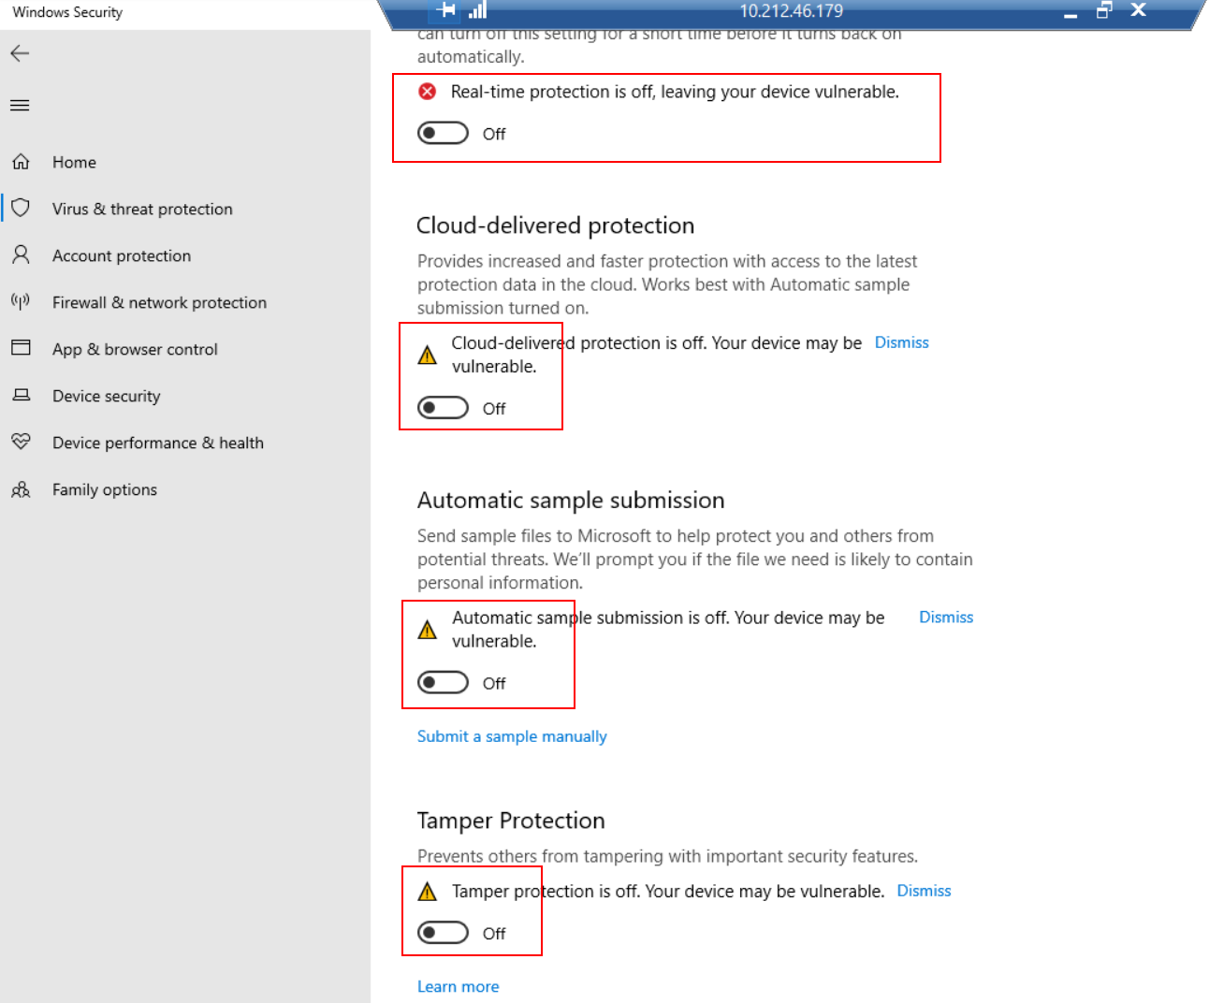
Disable Anti-virus (Win 10)

Slide 46
Solution: use pwdump 8
Try Firefox is Chrome doesn’t allow you to download
Or download from onedrive
http://www.blackmath.it/#Download

Slide 47
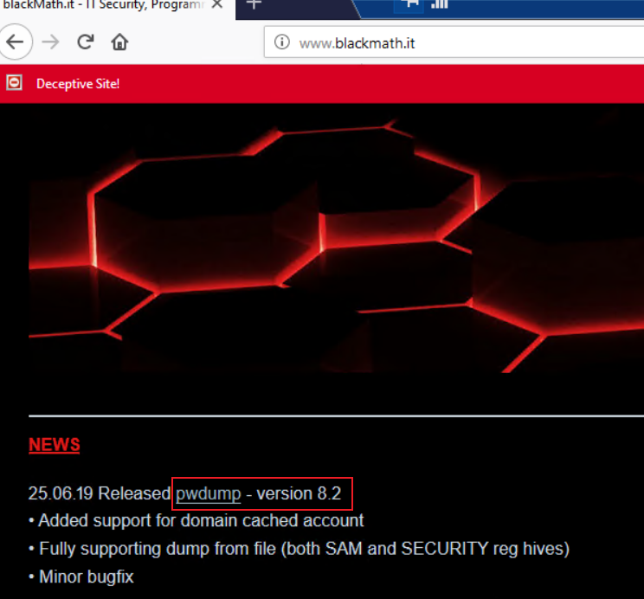
Download pwdmp 8.2

Slide 48
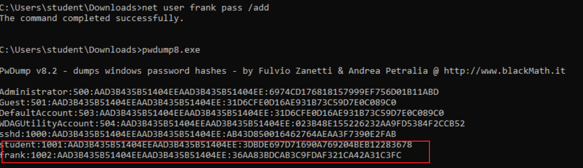
Hash from Win 10
Administrator:500:AAD3B435B51404EEAAD3B435B51404EE:6974CD176818157999EF756D01B11ABD
Guest:501:AAD3B435B51404EEAAD3B435B51404EE:31D6CFE0D16AE931B73C59D7E0C089C0
DefaultAccount:503:AAD3B435B51404EEAAD3B435B51404EE:31D6CFE0D16AE931B73C59D7E0C089C0
WDAGUtilityAccount:504:AAD3B435B51404EEAAD3B435B51404EE:023B48E155226232AA9FD5384F2CCB52
sshd:1000:AAD3B435B51404EEAAD3B435B51404EE:AB43D850016462764AEAA3F7390E2FAB
student:1001:AAD3B435B51404EEAAD3B435B51404EE:3DBDE697D71690A769204BEB12283678
frank:1002:AAD3B435B51404EEAAD3B435B51404EE:36AA83BDCAB3C9FDAF321CA42A31C3FC

Slide 49
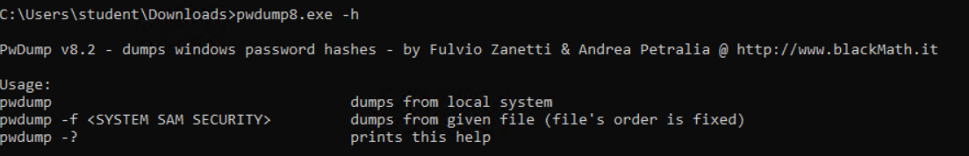
Help

